Slide 1
Digital Logic Design and Application
Lecture #05

Slide 2
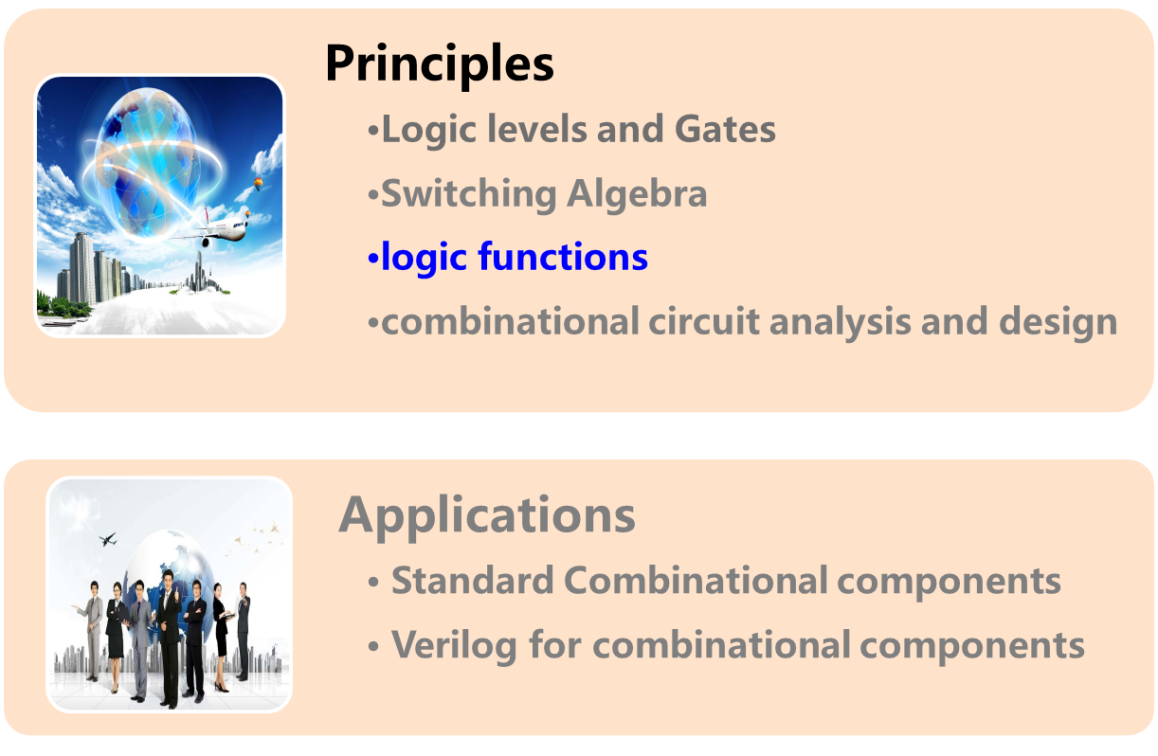
Topic 2-1 combinational circuits design

Slide 3
Last lecture
Standard representation of logic function
  Truth table
  Canonical sum/ product
  Minterm list and Maxterm list
Other representation of logic function
  Logic circuits
  Logic equations
  Waveform charts
  HDL codes
Standard ≠ simple
F(A,B)=AB + A’·B
=∑_{A,B}(1,3)
= B
Simplified logic function
Minimized digital circuit
Yan Chen. UESTC

Slide 4
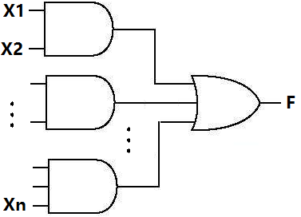
Logic circuit minimizations
Chap. 3.3
Minimize the inputs on each first-level gate.
Minimize the number of first-level gates.
Minimize the inputs on the second-level gates. This is actually a side effect of the second reduces.
Yan Chen. UESTC

Slide 5
Logic function simplification——algebra way
A·B+A·B’=A(B+B’)=A
A+A·B = A
A·B + A’·C + B·C = A·B + A’·C
A + A’·B = A + B
A+A=A; A+A’=1
…….
(combining)
Minterm: 1 1 1 0 → 1 ↔ A
Question 1: Is there a graphical way to make it easier?
(covering)
(consensus)
(idempotency &complement)
Yan Chen. UESTC
Notes:
If there’s a graphical way to put these special terms next to each other then it’s easy to combine them and simplify logic functions.

Slide 6
Logic function simplification-by K-map
Karnaugh map（卡诺图） is a graphical representation of a logic function’s truth table.
In 1953 Maurice Karnaugh, a telecom engineer from bell LABS, invented Karnaugh map or K – map. It is widely applied in the digital logic and fault diagnosis areas.
Yan Chen. UESTC

Slide 7
Logic function simplification-by K-map
A K-map for an n-input logic function has 2^{n} cells where each cell represents a possible input combination and it’s output.
Labels of a K-map correspond to the input combinations which is arranged in Gray codes.

Slide 8
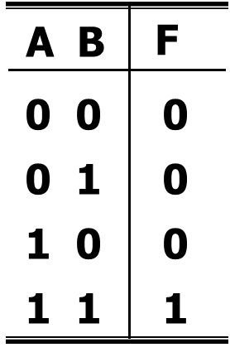
Logic function simplification-by K-map
X
F
0 1
X
0 1
Y
Y
0
1
0
_{F(0,0)}
2
_{F(1,0)}
0
1
0
0
1
_{F(0,1)}
3
_{F(1,1)}
0
1
Gray Code
F(X,Y,Z)
XY
00 01 11 10
Z
0
0
2
6
4
1
1
3
7
5

Slide 9
Logic function simplification-by K-map
W
F
WX
2-bit Gray Code
00
01
11
10
F(W,X,Y,Z)
YZ
0
4
12
8
W X Y Z
0 0 0 0
…
…
1 1 1 1
00
1
5
13
9
01
Z
3
7
15
11
11
Y
2
6
14
10
10
X

Slide 10
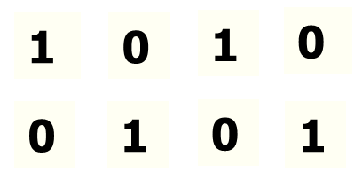
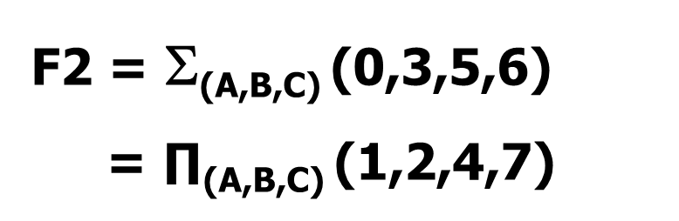
Logic function simplification-by K-map
Karnaugh map can be filled by simply copying the outputs of truth tables into the corresponding cells
A
B
C
F2
0
1
2
3
4
5
6
7
0 0 0 1
0 0 1 0
0 1 0 0
0 1 1 1
1 0 0 0
1 0 1 1
1 1 0 1
1 1 1 0
AB
00 01 11 10
C
₀
₂
₆
₄
0
₁
₃
₇
₅
1
1-cell → Minterms in the Minterm list
0-cell → Maxterms in the Maxterm list
Notes:
Each 1-cell in a K-map corresponds to a Minterm contained in the standard representation of the logic function.
Each 0-cell in a K-map corresponds to a Maxterm contained in the standard representation of the logic function.

Slide 11
Logic function simplification-by K-map
F₁ = Π_{(A,B,C)} (1,3,4,7)= ∑_{(A,B,C)} (0,2,5,6)
F₁
C
0 1
AB
00
1
0
F₁
AB
00 01 11 10
C
01
1
0
0
1
1
1
0
11
1
0
1
0
0
0
1
10
0
1
Question 2： which way do you prefer?
Yan Chen. UESTC

Slide 12
Logic function simplification-by K-map
Gray coded coordinates make geometry adjacent also logic adjacent.
Logic Adjacent(逻辑相邻)
  A cell and its immediately adjacent neighbors differ only in one variable.
F₁
AB
00 01 11 10
C
0
001 011
F₁(A,B,C) =A’B’C+A’BC
1
1
1
Yan Chen. UESTC

Slide 13
Logic function simplification-by K-map
Combining adjacent cells to eliminate logic variables
  circling and combining adjacent “1” cells .
  Using combining law, X·Y+X·Y’=X, variables been equally times of “0”s and “1”s are eliminated. Variables always been 1s or 0s are kept.
  2^{i} adjacent cells can eliminate i variables.
F₁
AB
00 01 11 10
C
001 011
0
F₁(A,B,C) =A’B’C+A’BC
=A’C
1
1
1
0 1
Yan Chen. UESTC

Slide 14
1 literal can be eliminated from 2¹ adjacent 1-cells
XY
WX
00 01 11 10
00
01
11
10
Z
YZ
0
1
1
1
00
1
1
1
1
1
01
1
1
1
11
1
1
1
10
1

Slide 15
2 literals can be eliminated from 2² adjacent cells.
CD
XY
00
01
11
10
00 01 11 10
AB
Z
0
1 1 1 1
00
1
1
1
1
1 1 0 1
01
1
1
Y’
(0)
11
1
1
10
1
1
1
A’·B’·C’·D’
+ A’·B’·C·D’
+ A·B’·C’·D’
+ A·B’·C·D’
= A’·B’·D’
+ A·B’·D’
= B’·D’
(0 0)
Notes:
(0000+0010)+(1000+1010)=000+100=00

Slide 16
3 literals can be eliminated from 2³ adjacent cells.
CD
D’
AB
00 01 11 10
00
01
11
10
1
0
0
1
1
0
0
1
1
1
1
1
1
1
1
1
A
F (A,B,C,D) =A+D’

Slide 17
Example: F = Σ_{A,B,C,D} ( 0, 2, 3, 5, 7, 8, 10, 11, 13 )
1. Drawing map
AB
A’·B·D
B’·D’
00 01 11 10
2. Circling adjacent cells
  area of circle:
  as large as possible
  number of circle:
  as few as possible
  cells can be reused
CD
00
01
11
10
1
1
1
1
B·C’·D
1
1
1
B’·C
1
1
3. Write terms
F(A,B,C,D) = B’·D’ + B’·C + B·C’·D + A’·B·D

Slide 18
Distinguished “1” cells
Is there a order when circling?
Are there circles must have?
CD
AB
00 01 11 10
00
01
11
10
1
1
1
1
1
1
1
1

Slide 19
Terminologies
Distinguished 1-cell(奇异的“1”单元)
  An input combination that is covered by only one circle.
CD
1-cells that can be covered by only 1 circle.
AB
00 01 11 10
00
01
11
10
1
1
1
1
1
1
1
1
1
1

Slide 20
Terminologies
CD
AB
00 01 11 10
Distinguished 1-cell
1
00
01
11
10
1
1
1
Begin with distinguished 1-cells
1
1
1
1

Slide 21
Example: F = Σ_{A,B,C,D} ( 0, 1, 2, 3, 4, 5, 7, 14, 15 )
1. Drawing map
AB
00 01 11 10
CD
2. Circling adjacent cells
00
01
11
10
1
1
marking distinguished 1-cell
1
1
circling 1 cells according to distinguished 1-cells
1
1
1
circling other 1-cells
1
1
3. Write terms, one per circled set
Get the minimal sum(最小和) or minimal product-of-sum (PoS)
F(A,B,C,D) = A’·B’ + A’·C’ + A’·D + A·B·C
Notes:
Circling as much as possible to find the distinguished 1-cells. Then start from circling the distinguished 1-cells. After that circles other 1-cells.

Slide 22
AB
AB
00 01 11 10
00 01 11 10
CD
CD
00
01
11
10
1
1
1
00
01
11
10
1
1
1
1
1
1
1
1
1
1
1
1
1
1
1
1
1
1
1
For some logic functions, the minimal expressions may be different, but are equally costly.

Slide 23
No distinguished 1-cells
AB
00 01 11 10
CD
00
01
11
10
1
1
1
1
1
1
Don’t repeat circle!
In each circle, there is at least ONE NEW 1-cell.

Slide 24
Minimizing Products of Sums
  Circle 1 cells to get minimal sum(最小和)
  Circle 0 cells to get minimal product (最小积)
A’+C
AB
00 01 11 10
Product-of-sum
0 → variable
1 → (variable)’
CD
00
01
11
10
0
0
0
0
0
A’+B
0
0
A+B’+C’+D
F = (A+B’+C’+D)·(A’+C)·(A’+B)

Slide 25
Minimization with Don’t-Care terms
“Don’t-Care” Input Combinations
  The input combinations are not allowed to happen, a.k.a illegal state
Eg. The unused code words of 8421 codes.
  the outputs for these inputs don’t matter, We don’t care about system behaviors under these inputs (out-of-range).
  In circuits minimization the outputs for don’t-care terms can be arbitrarily treated as 1 or 0 in truth tables and K-maps.
Yan Chen. UESTC

Slide 26
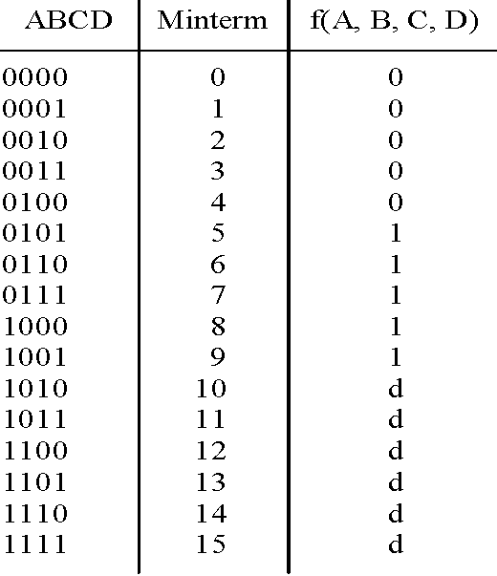
Example：BCD code decoder
(BCD码译码器)
Y0
Y1
Y2
Y3
Y4
Y5
Y7
Y6
Y7
Y8
Y9
1
1
1
1
1
d-set: minterm list for don’t care input combinations.
d(10,11,12,13,14,15)
restriction condition:
Σ_{A,B,C,D} (10,11,12,13,14,15)=0

Slide 27
“Don’t-Care” Input Combinations
In minimization outputs for don’t-care terms can be arbitrarily treated as 1 or 0.
  F = Σ_{A,B,C,D}(1,2,3,5,7) + d(10,11,12,13,14,15)
d-set
AB
00 01 11 10
CD
F = A’·D + B’·C
00
01
11
10
d
A’·D
+ B·D
1
1
d
B’·C
1
1
d
d
redundent
1
d
d

Slide 28
Requited reading
Digital Design: Principles and Practices, 4th Edition, John F. Wakerly, 4.3-4.5
Yan Chen. UESTC

Slide 29
Back ups
Yan Chen. UESTC

Slide 30
Logic function simplification-algebra way
Appling theorem: A·B+A·B’=A
F1 = A·(B·C’·D)’ + A·B·C’D
= A·[ (B·C’·D)’ + B·C’·D ]
= A
F2 = A·B’ + A·C·D + A’·B’ + A’·C·D
= B’ + C·D
F3 = B·C’·D + B·C·D’ + B·C·D + B·C’·D’
= B · ( C’·D + C·D’ + C·D + C’·D’ )
= B · ( C’ + C )
= B

Slide 31
Logic function simplification-algebra way
Appling theorem: A+A·B = A； A·（A+B）=A
F1 = (A’·B+C)·A·B·D + A·D
= A·D·[ B·(…) + 1 ]
= A·D
F2 = A·B + A·B·C’ + A·B·D + A·B·C·D’
= A·B+ A·B·D
= A·B
F3 = A + [A’·(B·C)’]’·[A’+(B’·C’+D’)’] + B·C
[A’·(B·C)’]’
= A + B·C
= A + (A+B·C)·[ … ] + B·C
= A+A·[ … ] + B·C·[ … ]+ BC
= A+BC

Slide 32
Logic function simplification-algebra way
Appling theorem: A·B + A’·C + B·C = A·B + A’·C
Y1 = A·C + A·B’ + B’·C’
= A·C + B’·C’
A’ + B
= [(A’+B)’]’
= (A·B’)’
Y2 = A·B’·C·D’ + (A’+B)·E + C·D’·E
= (A·B’)·C·D’ + (A·B’)’·E + C·D’·E
= (A·B’)·C·D’ + (A·B’)’·E
Y3 = A·B’ + B·C’ + C·D’ + D·A’ + A·C’ + A’·C
= A·B’ + B·C’ + C·D’ + D·A’

Slide 33
Logic function simplification-algebra way
Appling theorem: A + A’·B = A + B
Y1 = A·B’·C’·D + (A·B’·C’)’
= B’·C’ ·(A·D) + A’+(B’·C’)’
=…= A’+B+C+D
Y2 = A + A’·C·D + A’·B·C’
= A + A’·(C·D + B·C’)
= A + C·D + B·C’
Y3 = A·C + A’·D + C’·D
= A·C + (A’+C’)·D
= A·C + (A·C)’·D
= A·C + D

Slide 34
Logic function simplification-algebra way
Appling theorem: A+A=A; A+A’=1
Y = A·B’ + A’·B + B·C’ + B’·C
= A·B’ + A’·B·(C+C’) + B·C’ +B’·C·(A+A’)
= A·B’ + A’·B·C + A’·B·C’ + B·C’ + A·B’·C + A’·B’·C
= A·B’
+ A’·C
+ B·C’
Y = A·B’ + A’·B + B·C’ + B’·C
也可添加 A·C’
= A·B’ + A’·B + A·C’ + B·C’ + B’·C + A·C’
= A’·B + A·C’ + B’·C
Different result with the same cost.

